Slide 1
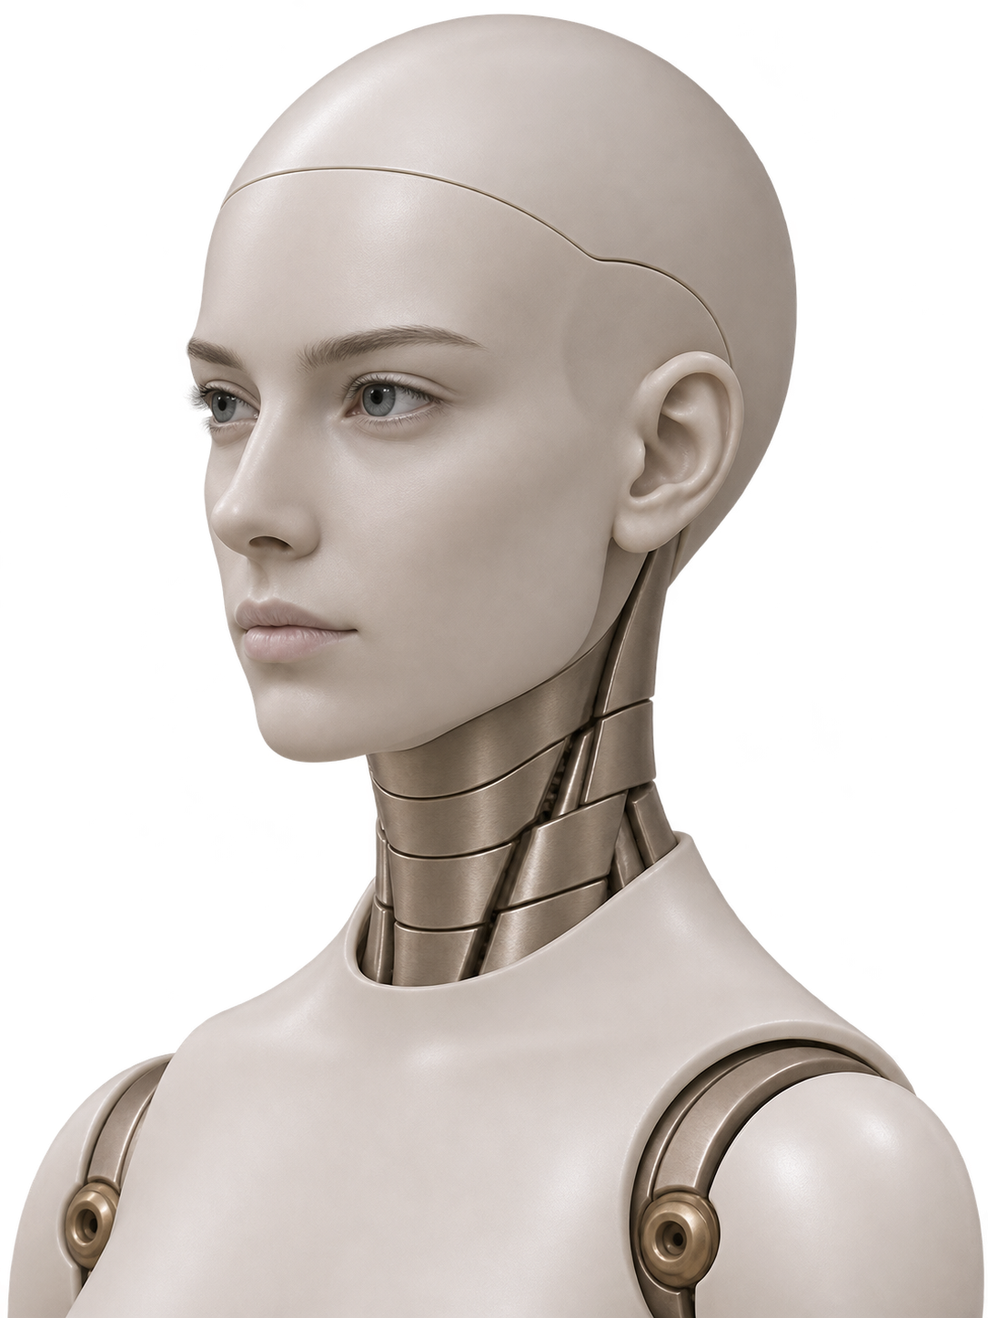
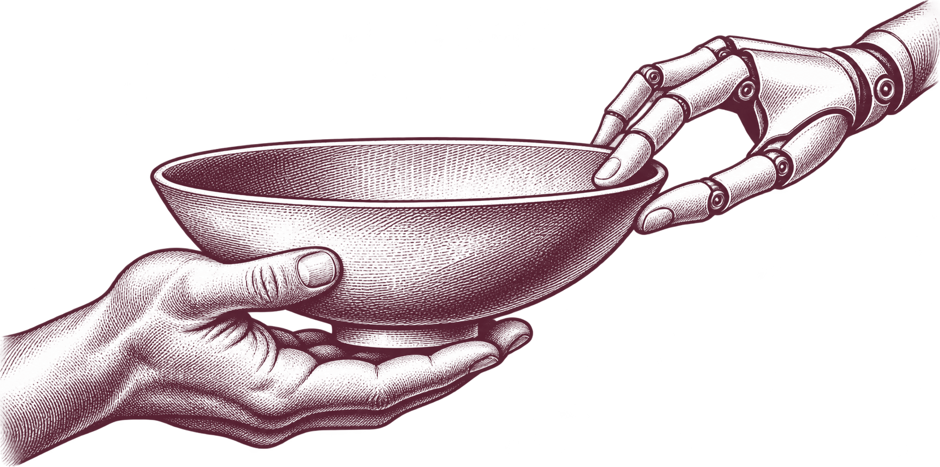
The Human
Touch
Notes:
Shared Vessel. The human carries the bowl; Emmy steadies its rim. The emblem, title and portrait are separate slide objects.

Slide 2
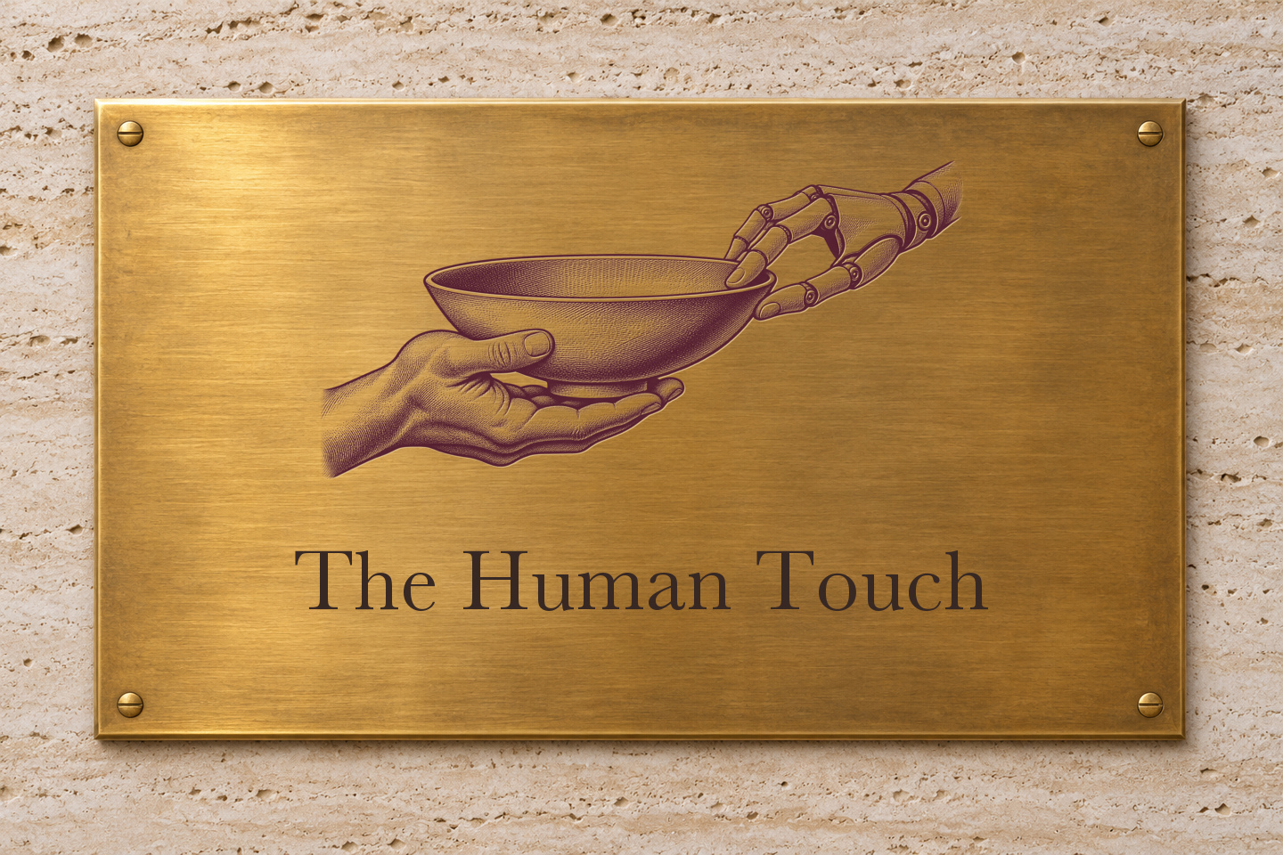
Notes:
Brass fabrication concept. Use a physical proof to determine which hatch lines will reproduce at final size.

